Slide 1

Beyond the Hype: Navigating the Security Challenges of 5G and IoT
Advanced Cryptography and Digital Forensics workshop IIIT Kottayam June 05-09 2023
Dr. Ragesh G K
Dept. of Cyber Security
IIIT Kottayam.

Slide 2
The flow..
Introduction to 5G, IoT, Various use-cases
Security Challenges
Security Protocols
System Models and Security Requirements
Future Research Directions

Slide 3
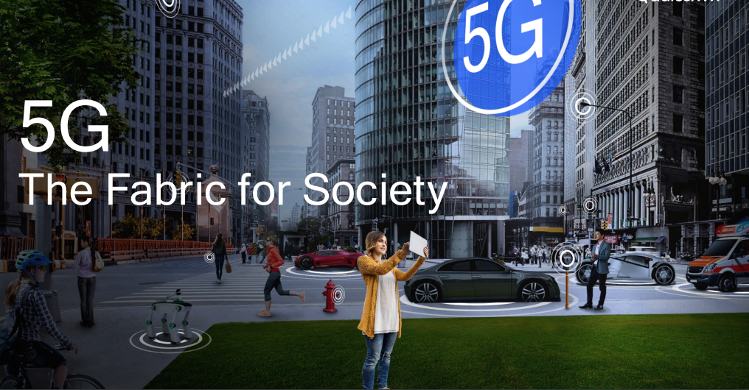

Slide 4
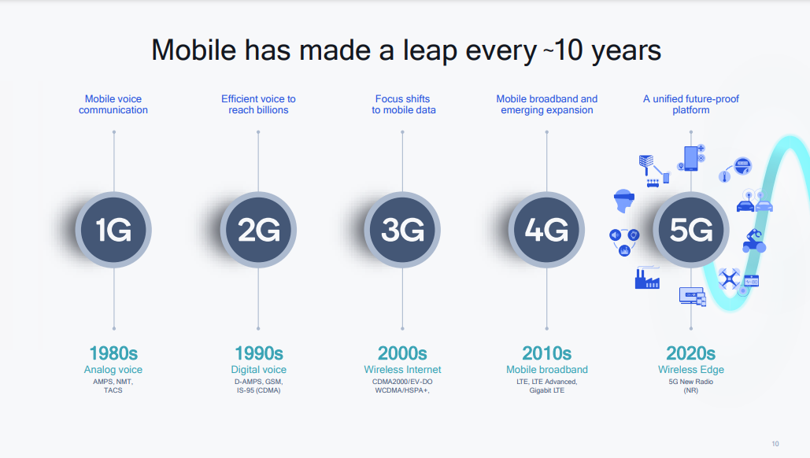

Slide 5
Racing towards 5G
provides broadband access.
new and major breakthrough innovation in a broadband connection.
Quicker system speeds and a much more personalized web experience through a technique called Network Slicing, (creating separate wireless networks in the cloud, allowing users to create their spot network as per their usage and requirement)
will be crucial for self-driving cars
help in linking and controlling robots, but also boost the efficiency of medical devices, industrial equipment, and agricultural machinery.

Slide 6
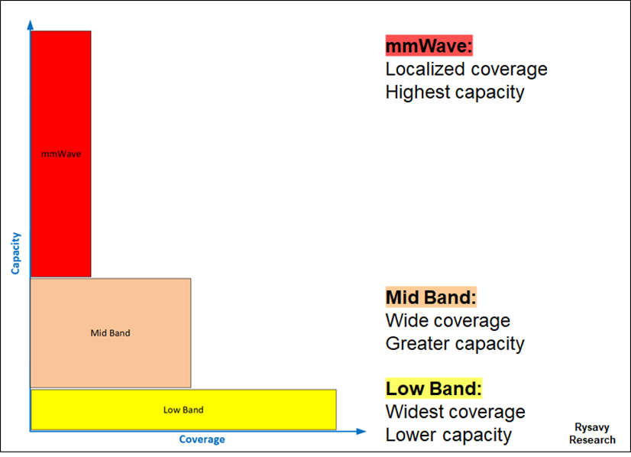
Three-Tier Spectrum Usage for 5G

Slide 7
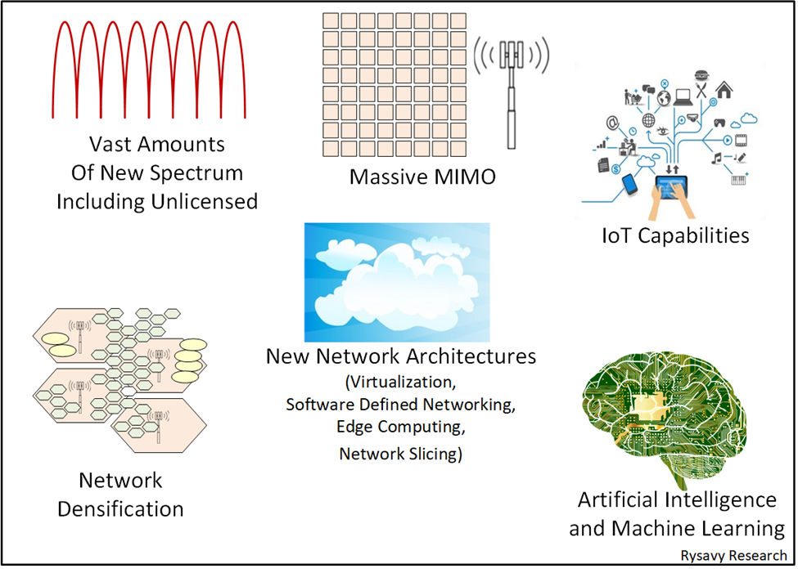
Fundamental Transformational Elements

Slide 8
5G Solutions for IoT
Ultra-Reliable Low Latency Communications (URLLC)
- critical for enterprise IoT use cases (automatic control of industrial
devices and autonomous self-driven vehicles)
- smart city (to manage traffic more efficiently, prevent
congestion and warn of accidents ahead,
benefitting road-users)
- smart home applications (online gaming and AR/VR devices)

Slide 9
5G Solutions for IoT
Non-Public Networks (Private Networks) - as networks which serve the needs of enterprises.
Examples: campus networks in universities, hospitals or military bases, as well as
maritime ports, manufacturing sites or transport hubs.
Industrial IoT applications often require a high level of security and reliability. These include
- Industrial robots
- Factory vehicles
- Predictive maintenance
- Connected tools
- Wearable technology

Slide 10
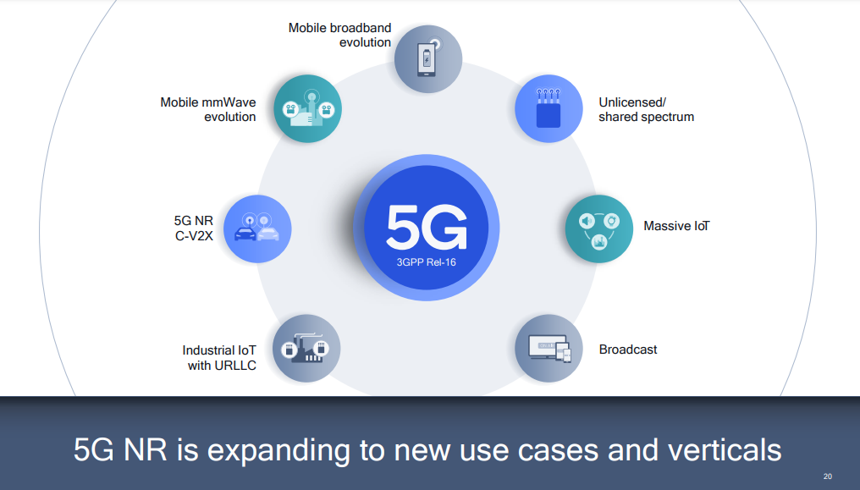

Slide 11
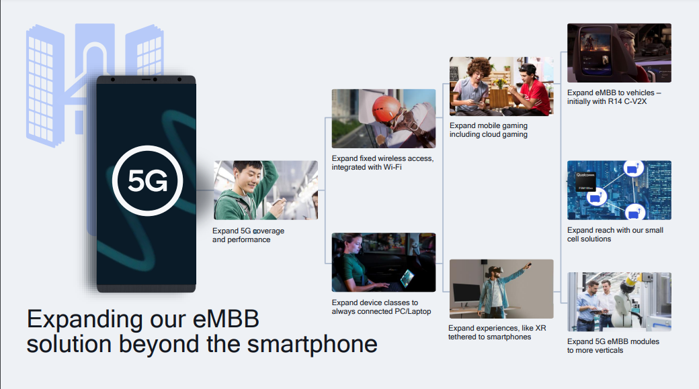

Slide 12
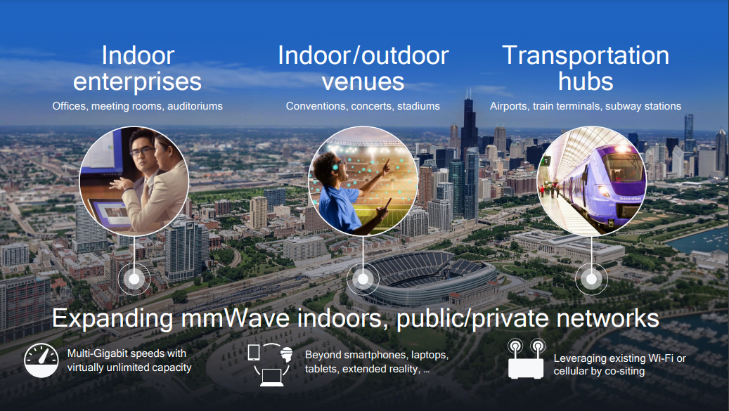

Slide 13
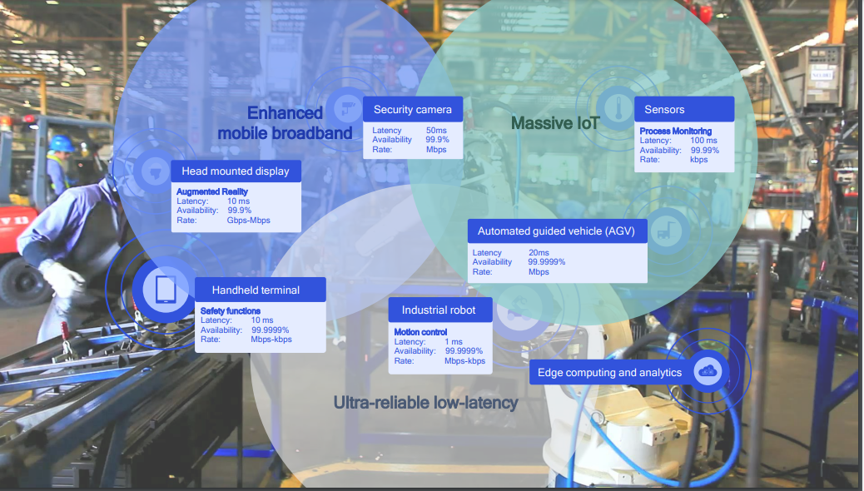

Slide 14
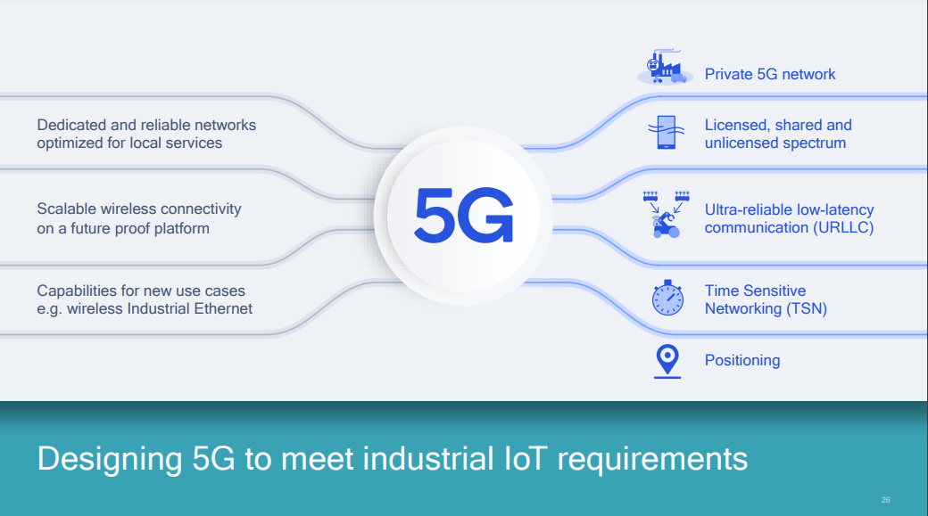

Slide 15
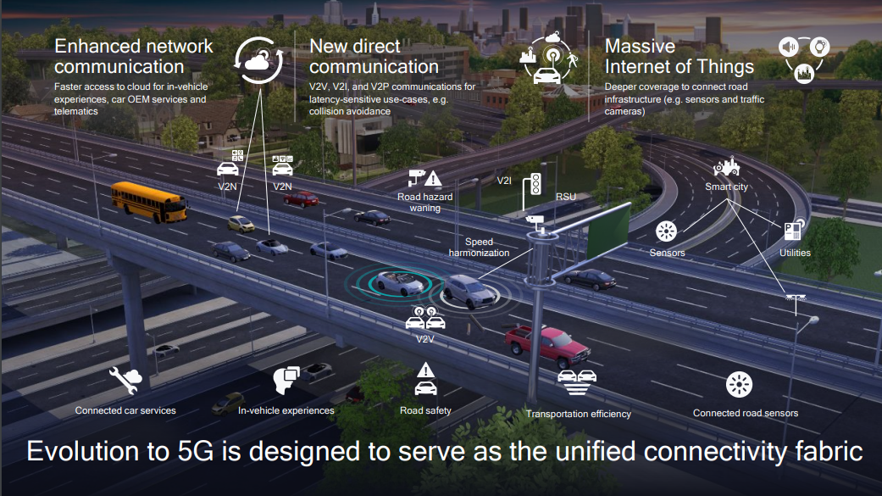

Slide 16
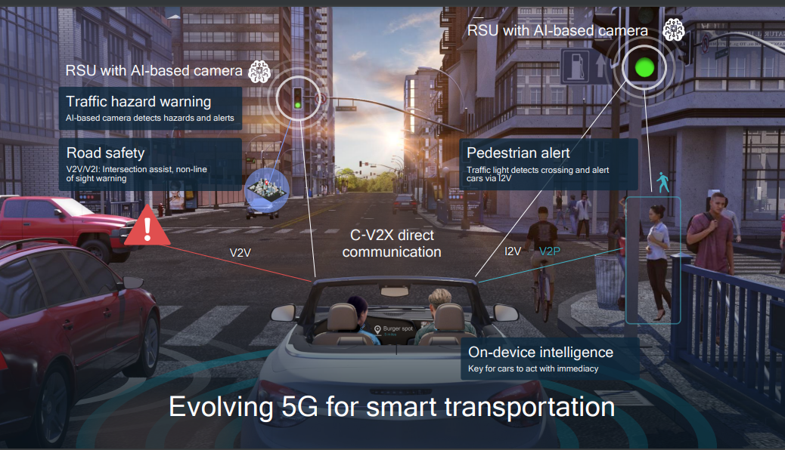

Slide 17
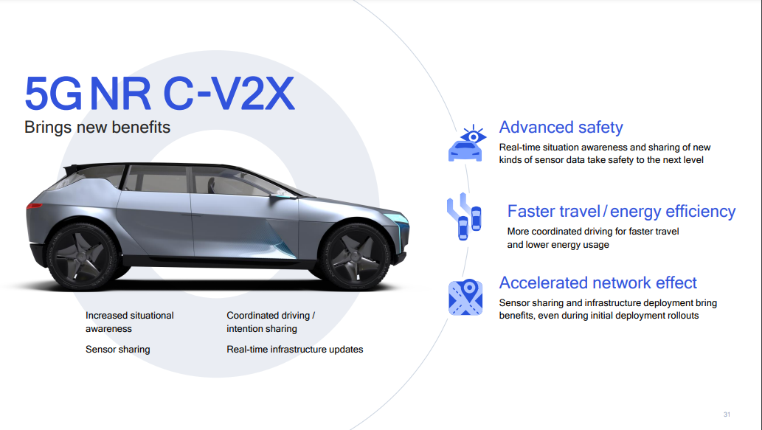

Slide 18
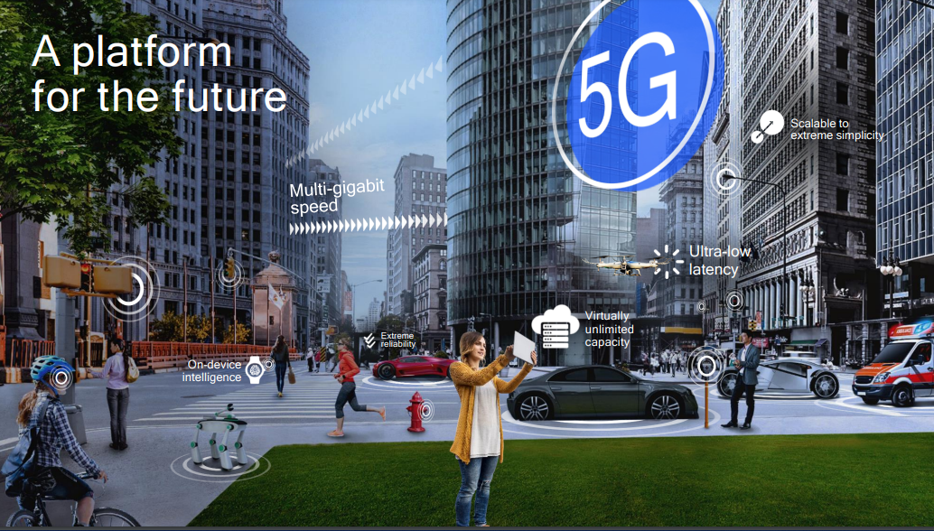

Slide 19
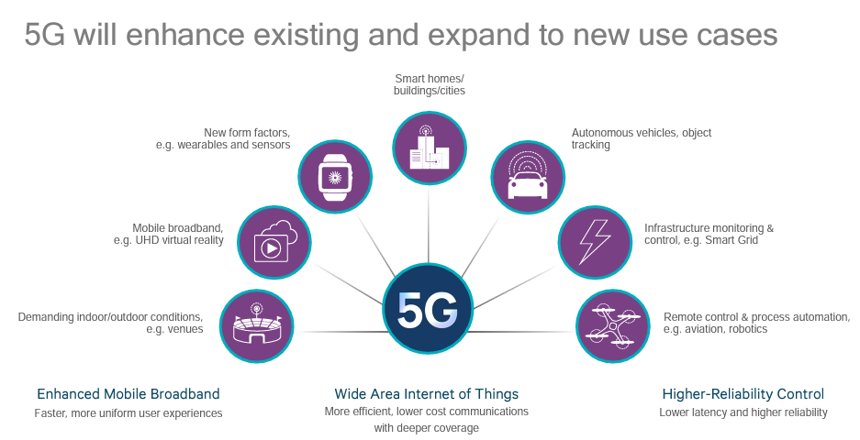

Slide 20
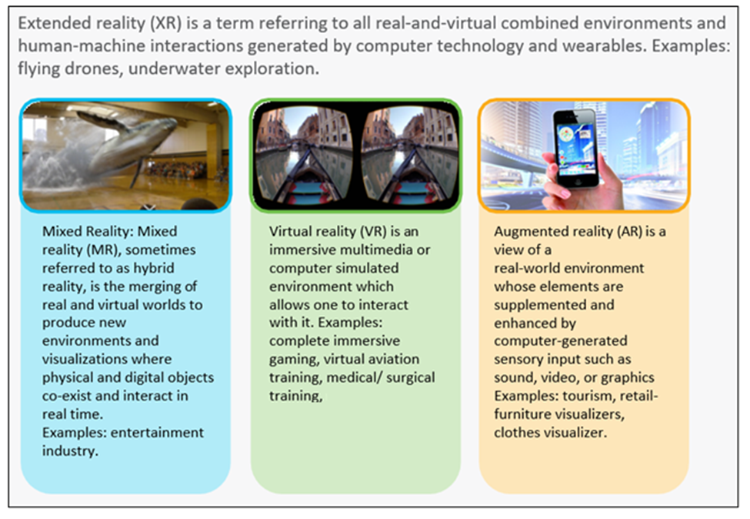
VR, AR, Mixed, and Extended

Slide 21
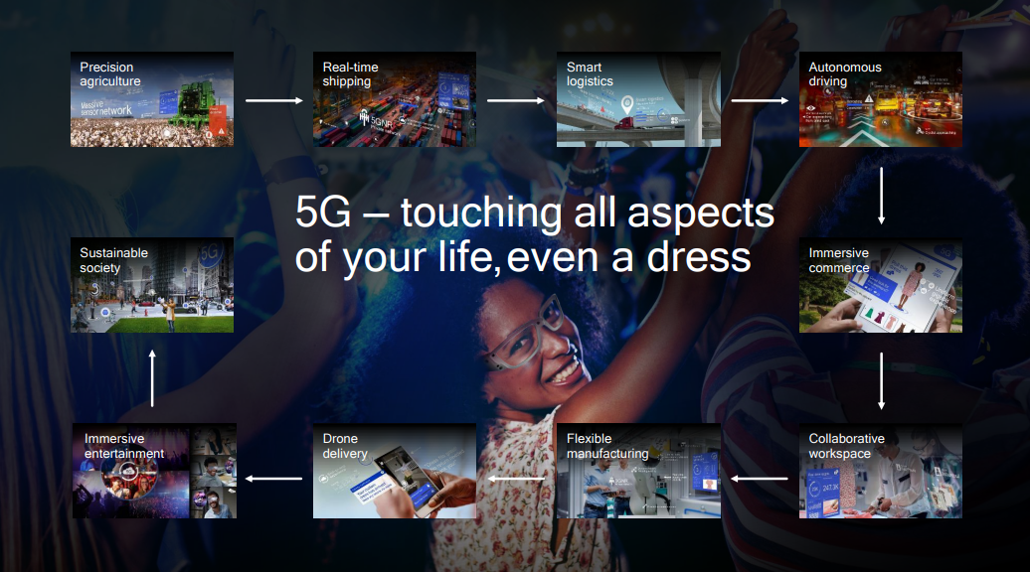

Slide 22
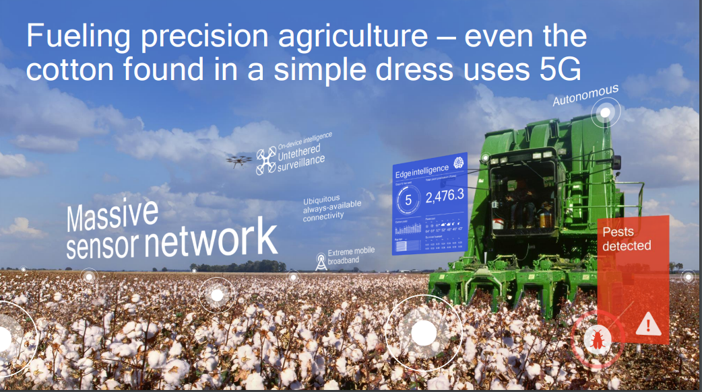

Slide 23
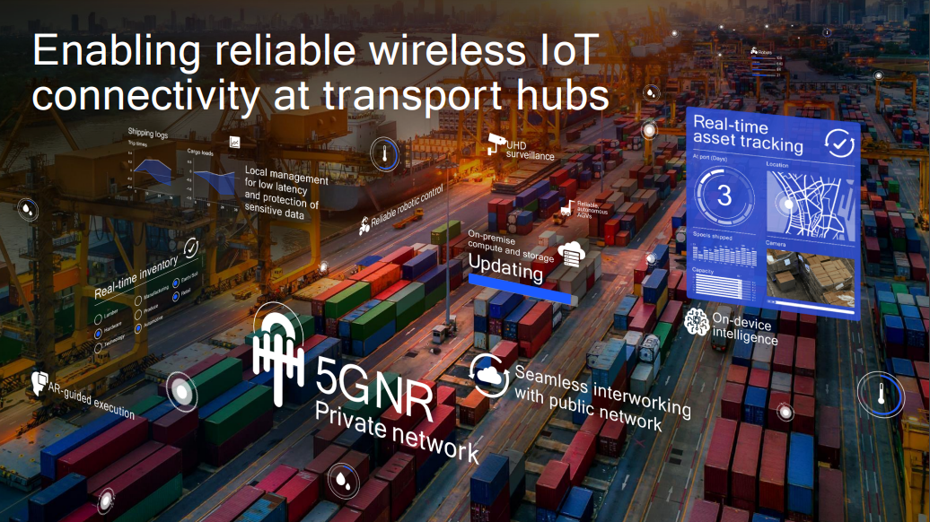

Slide 24
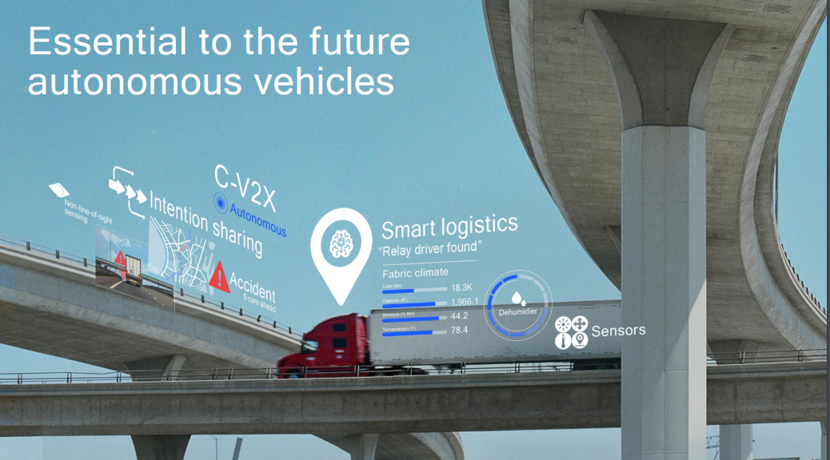

Slide 25
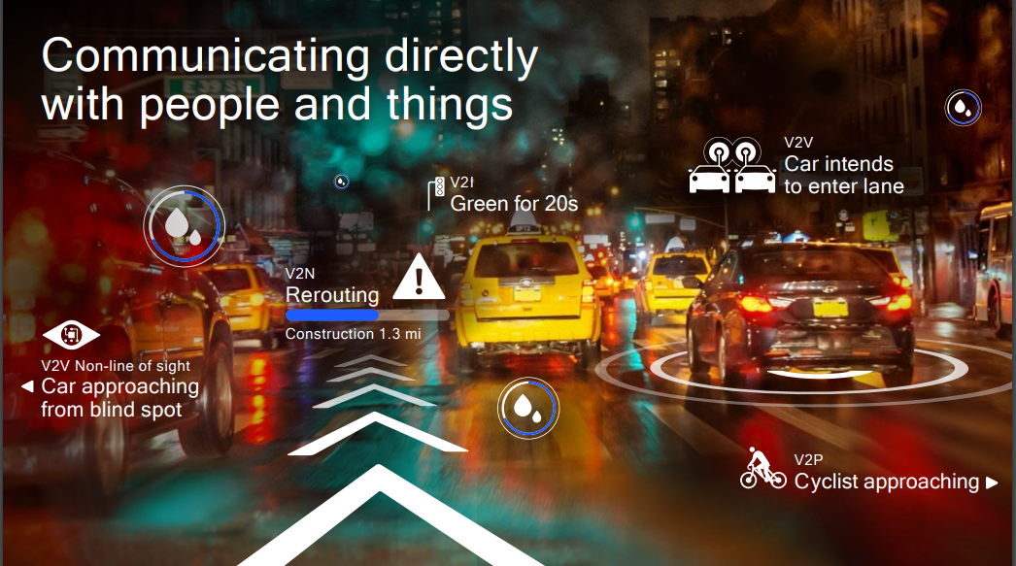

Slide 26
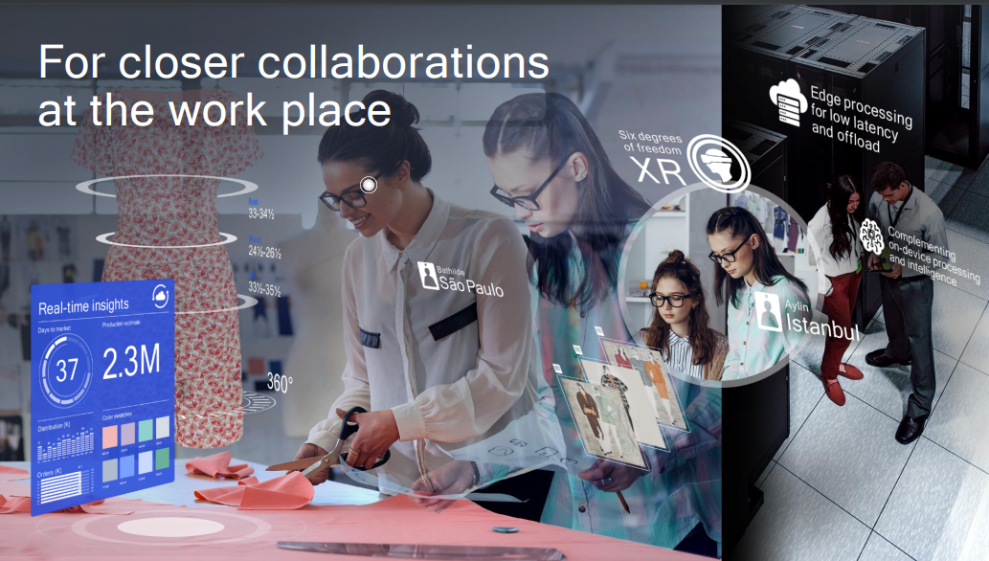

Slide 27
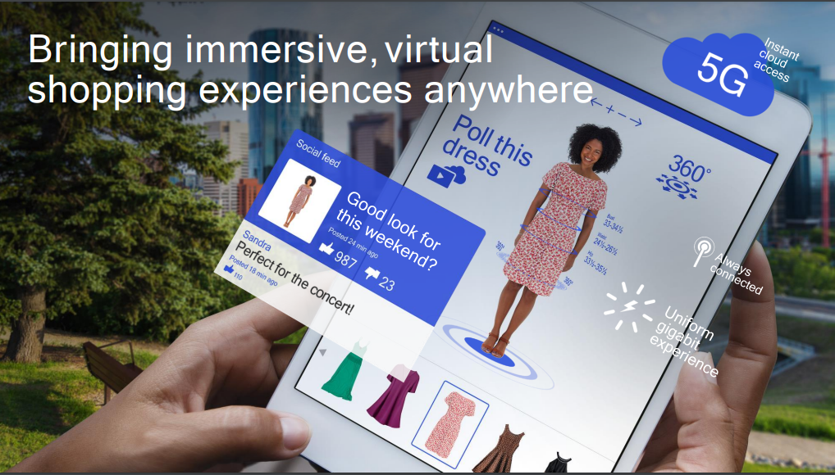

Slide 28
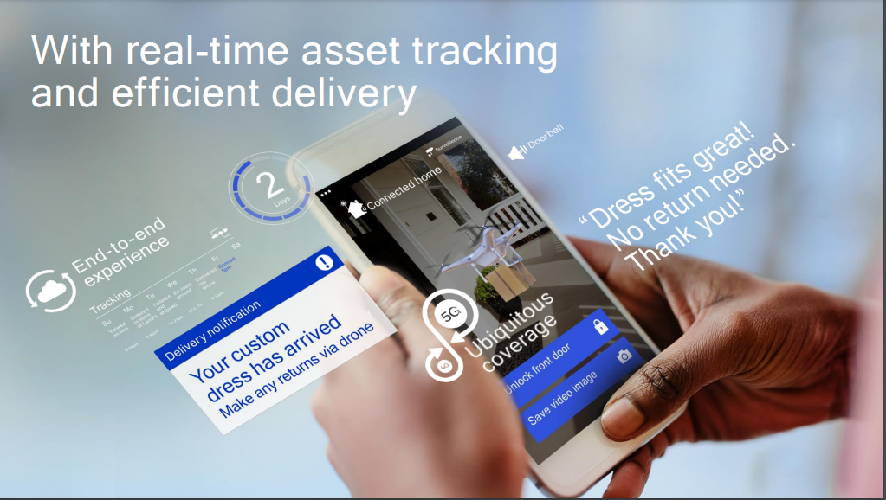

Slide 29
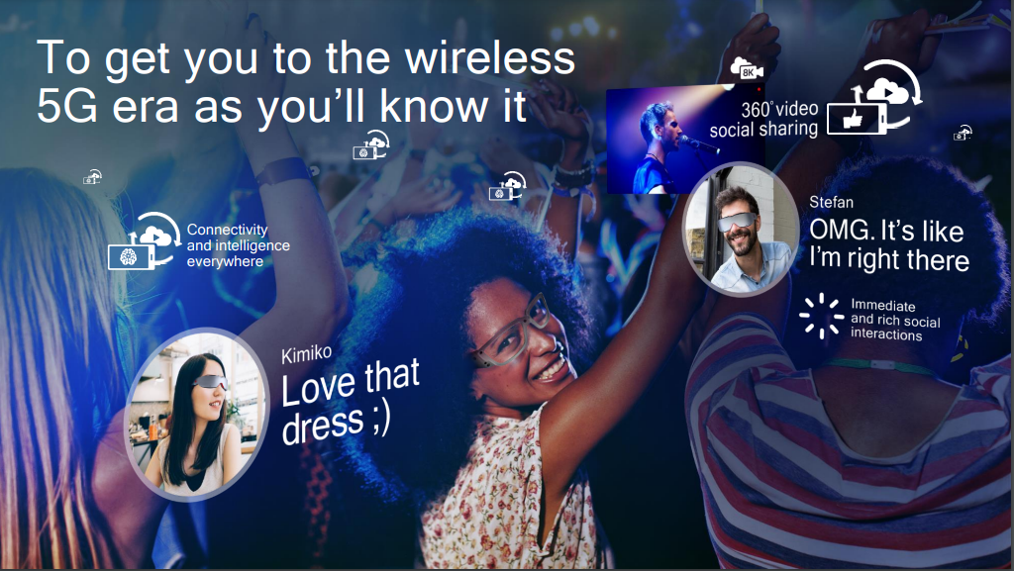

Slide 30
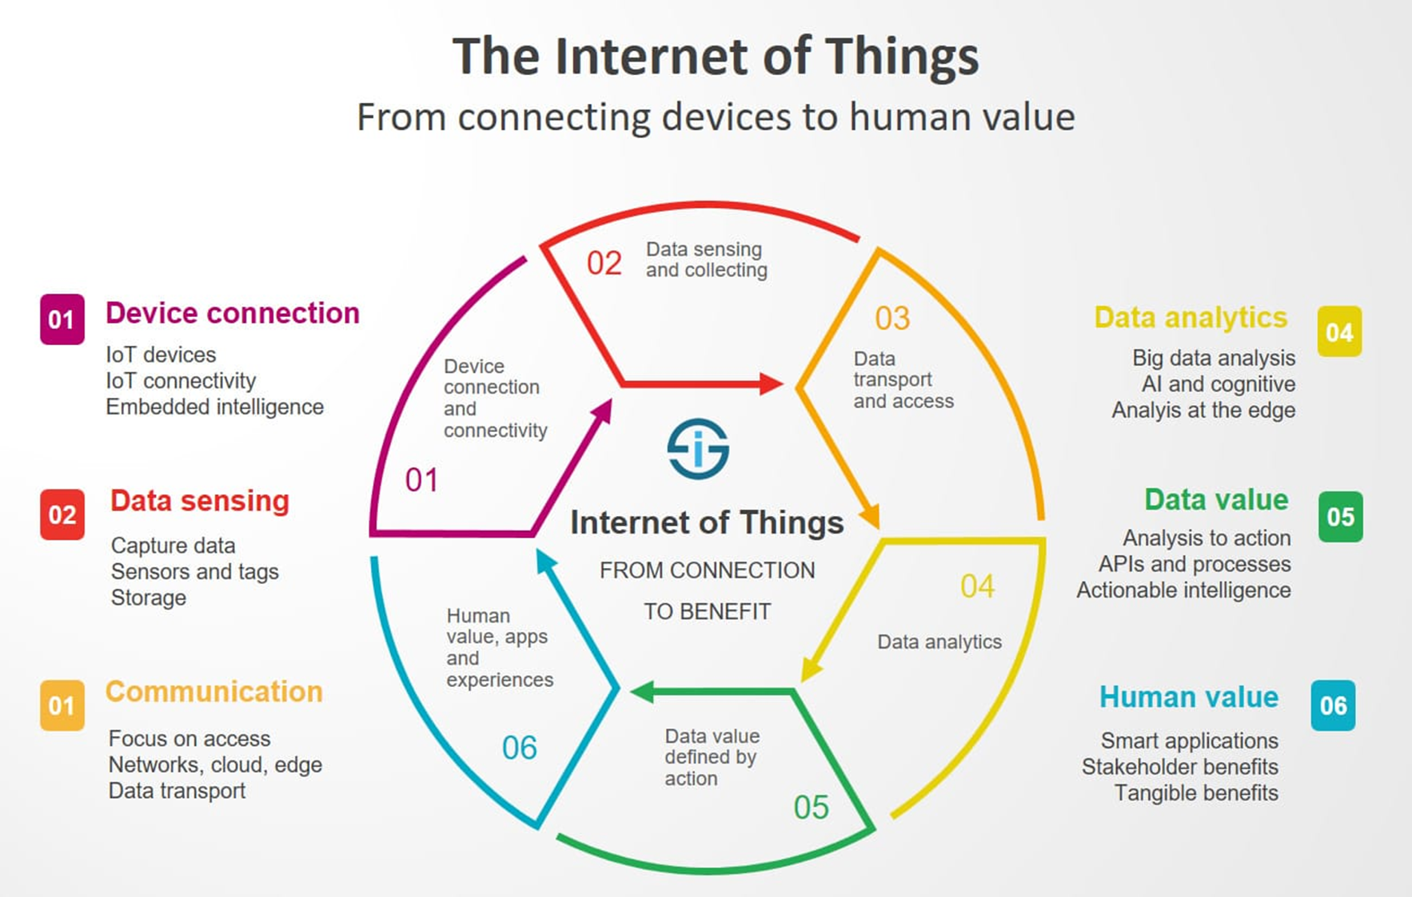

Slide 31
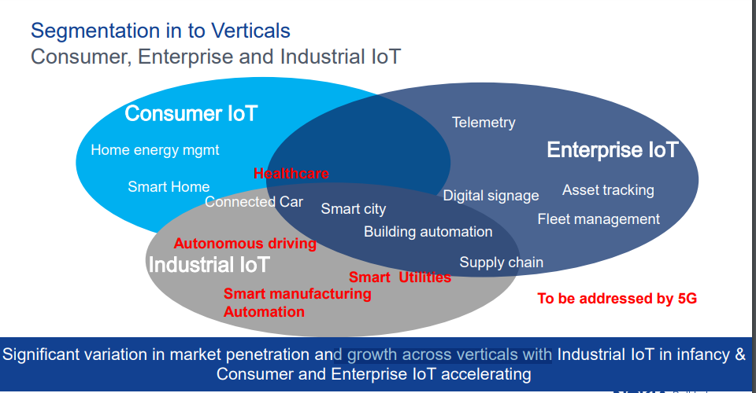

Slide 32
What does 5G mean for IoT?
IoT in the 5G system will be a game-changer in the future generation.
It will open a door for new wireless architecture and smart services.
Existing cellular networks, like LTE (4G), will not be sufficient
Require higher data rates, more bandwidth, low-latency quality of service (QoS), and low interference.
5G will also allow for an expansion of IoT use-cases

Slide 33
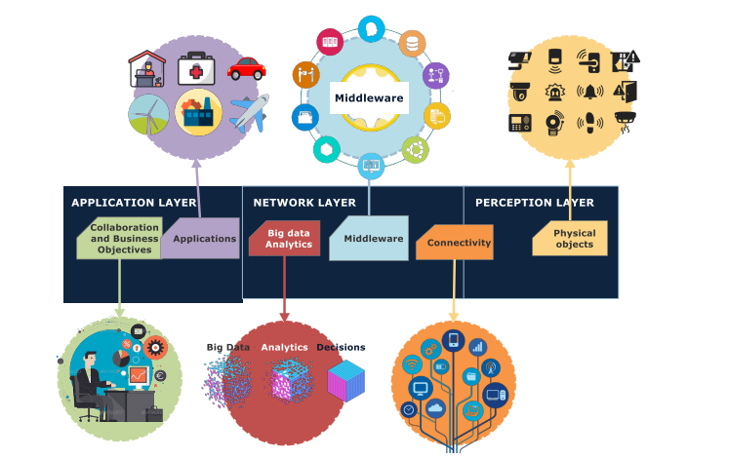
Architecture of a typical IoT framework with application in Smart Cities

Slide 34
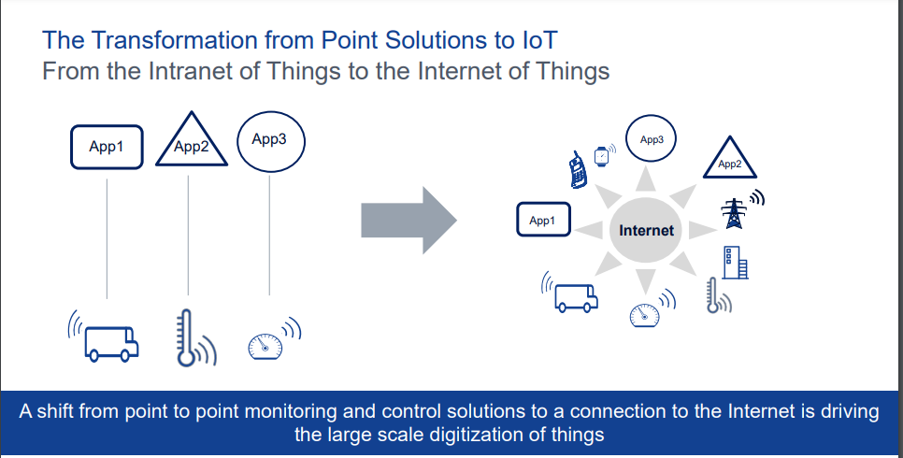

Slide 35
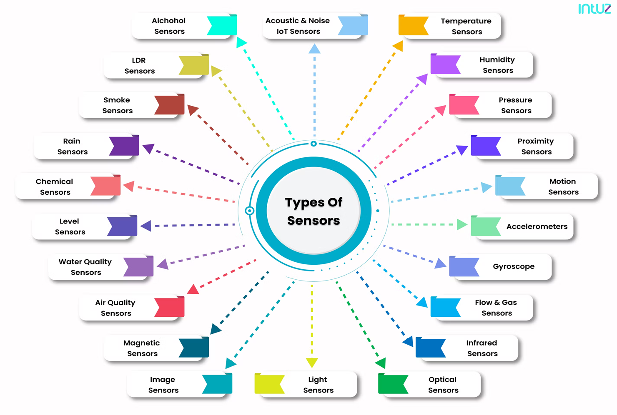

Slide 36
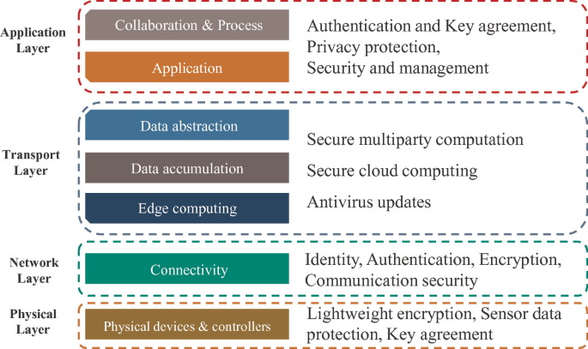

Slide 37
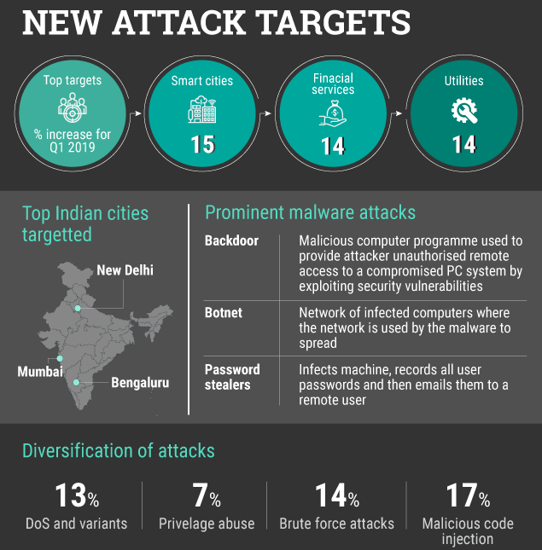

Slide 38
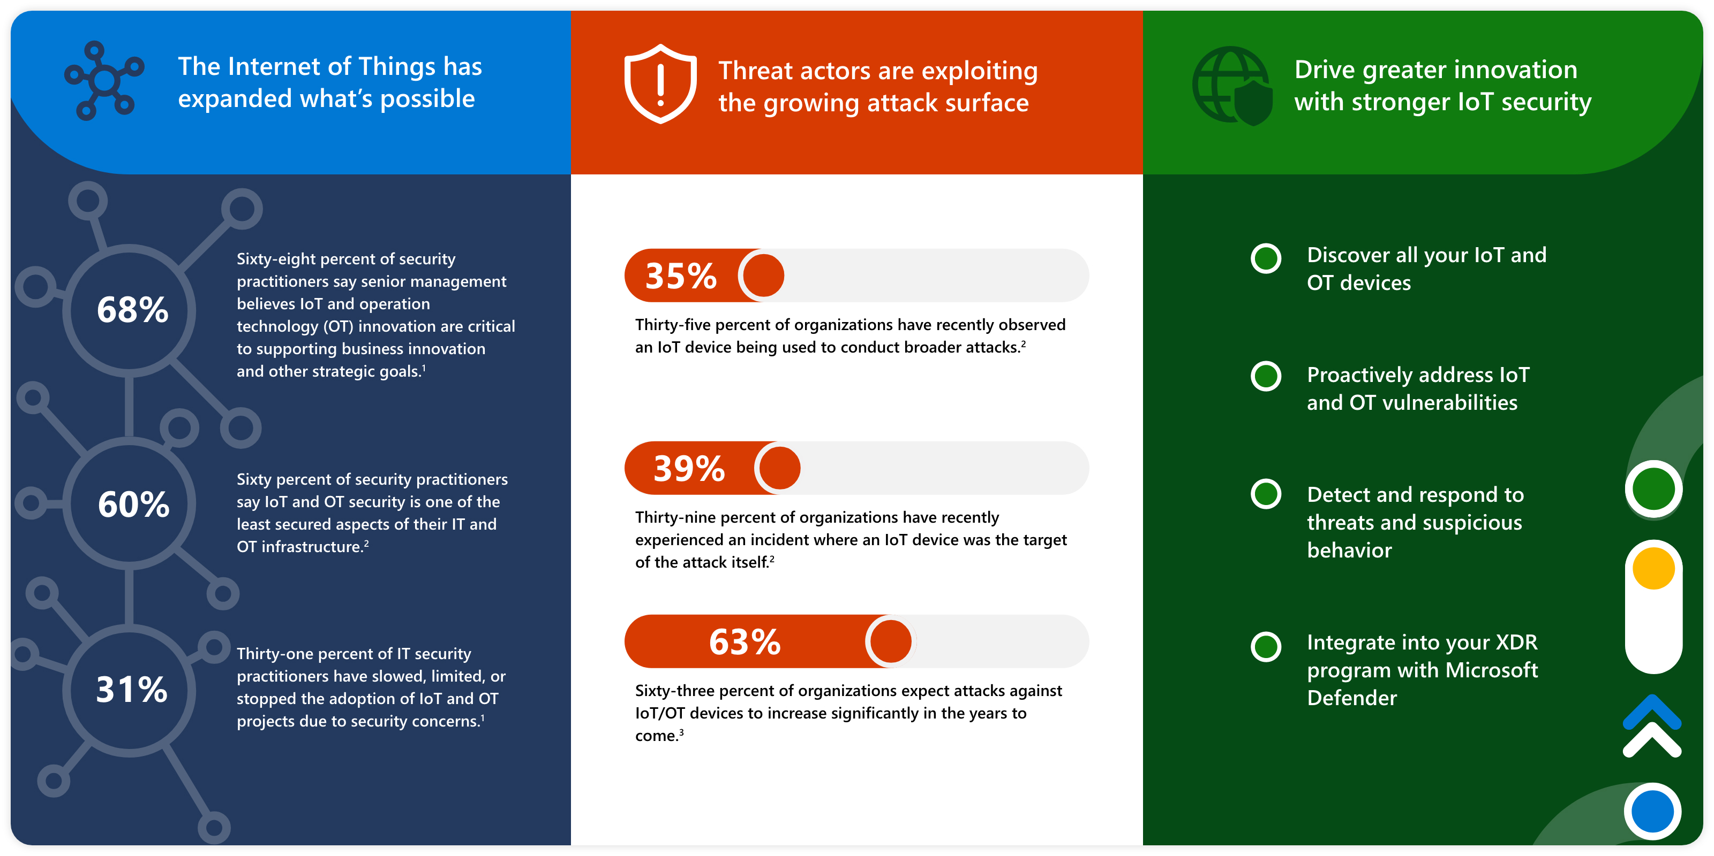
Why IoT security
Attacks on IoT infrastructure are not hypothetical. Adversaries increasingly use these devices to evade detection and stage broader attacks.

Slide 39
Need for Security in IoT and Challenges
Data Privacy: IoT devices collect and transmit sensitive data, such as personal information and business data. Protecting this data from unauthorized access and ensuring privacy is essential.
Device Security: IoT devices often have limited computational capabilities, making them susceptible to attacks. Compromised devices can be used as entry points to launch attacks on networks or gain unauthorized access to other devices.
Network Security: IoT devices rely on networks to transmit data. Securing the network infrastructure, including the communication channels and gateways, is vital to prevent unauthorized access and data interception.
Lack of Standards: The lack of standardized security measures across IoT devices poses a challenge. Varying security protocols, vulnerabilities, and insufficient update mechanisms make it difficult to ensure uniform security across the IoT ecosystem.

Slide 40
SECURITY AND PRIVACY ISSUES

Slide 41
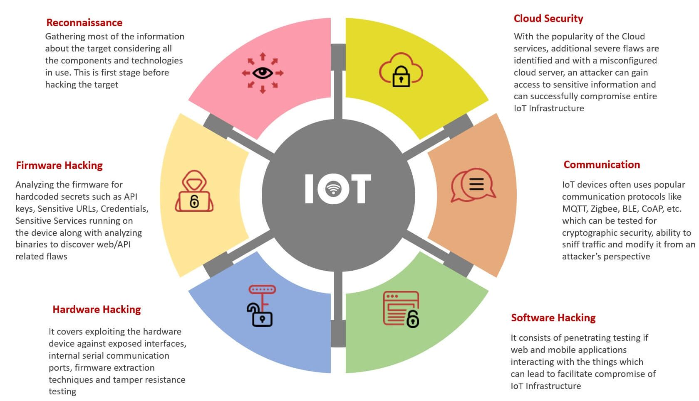

Slide 42
Lack of robust security schemes
IoT devices are connected with the system i.e., desktop or smartphone.
Lack of security mechanism improves the threat of leakage of personal data.
The collected and transmitted data of IoT devices may be disclosed (i.e., health data collected through smart healthcare devices).

Slide 43
Openness of the network
It is necessary to connect IoT devices with a consumer network which have connection with the other the systems.
IoT devices comprehend with some security vulnerabilities, which may be harmful for the network of the consumers.
It may become the entry point for the attacker to get entry into the system.

Slide 44
Privacy of sensitive data
IoT environment consists of different types of devices, which have various types of hardware and software.
vulnerable to different attacks i.e., replay, impersonation, password guessing, etc.
sensitive data may be leaked through unauthorized access and manipulations.
Devices transmit user’s personal information such as name, address, contact number, date of birth, health data and credit card.

Slide 45
SECURITY REQUIREMENTS

Slide 46
Authentication Procedure
Integrity Property
Confidentiality Property
Non Repudiation property
Authorization procedure
Freshness property
Availability property
Forward Secrecy Property
Backward Secrecy property
Validate the identities
Assurance of real and accurate data
Protection of information against unauthorized access
Should not deny the validity of something
Used to regulate device or user privileges (Access control)
Assurance of data freshness
Assurance that information is available to genuine entities.
Leaving the network means no access to future messages.
Newly deployed entities cannot access past messages

Slide 47
Most widely used protection approaches
Authentication
Authorization
Trust Establishment
Exhaustion of resources

Slide 48
Authentication
TLS is commonly used for communication authentication and encryption.
Light weight authentication for encrypted communication and access control.
In M2M Connectivity, for identity authentication , there are 3 sequential phases
Key generation Phase: ECC-Diffie-Hellman algorithm is used to produce a hidden key
Establishment Phase: Determining device identity using one way or shared authentication protocol.
Implementation Phase: Requires authenticated devices to connect with one another by granting access control.

Slide 49
Authorization
In terms of records security and access control, authorization refers to the method of determining access privileges to facilities, such as medical equipment.
One method for treatment and tracking of data is ID authentication of sensor nodes.
This method contains necessary encryption, timestamp as well as ID of the key and the node.
The communicating parties verify each other’s timestamps and can also use them to terminate a session.

Slide 50
Exhaustion of Resources
Any node in range of the malicious node can affect the whole system by depleting all the battery resources.
If the attackers’ packets evoke a transmitted response time, battery depletion is accelerated.
Many nodes become useless by these attacks and sub-networks may become inaccessible, which makes resource depletion attacks a double-edged sword compared to DoS attacks.

Slide 51
Trust Establishment
Trust is crucial for system interoperability and safeguarding consumer privacy in IoT.
Establishing trust ensures protection of personal user information and enables effective access control and authorization.
A shared trust paradigm and item-level access-control architecture can be implemented for IoT security.
Key formation and token-based structures are utilized to maintain trust and authorize communication between devices.

Slide 52
From the literature..
Research on Secure Communication –Key takeaways
Network Layer
Device centric
Light weight authentication method.
U2M , M2M communication Domains- Generic, BAN, VANET
Advantages: Reduction of overhead, mutual authentication, certificate less authentication , social networking based authentication protocol etc.
Analysis tool: Cooja, Matrix Laboratory, NS3, NS2, MICA2 etc.

Slide 53
From the literature..
Research on Access Control
Layer: Application
Device Centric
Light weight scheme
U2M, M2M
Domain: Generic, WSN, VANETs, Medical, BAN etc.
Advantage: Multi factor authentication, Lightweight authentication, authentication based on bio hashing, access admission control on capacity, smart card assisted authentication etc.
Analysis tool: Matrix laboratory, C++, Cooja, NS2, Test-bed etc.

Slide 54
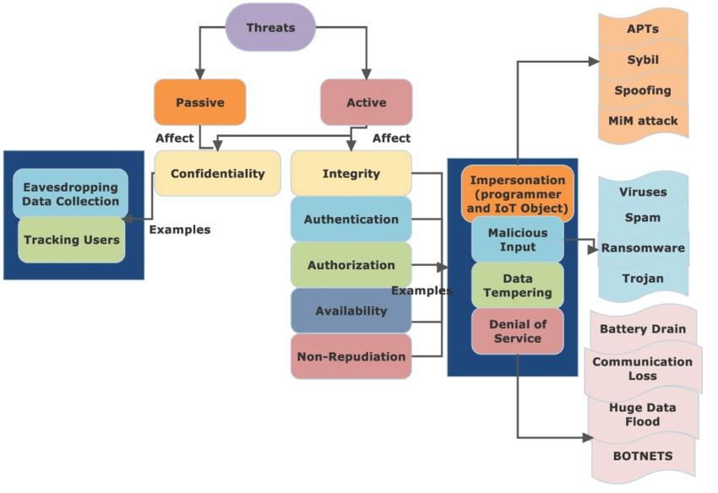

Slide 55
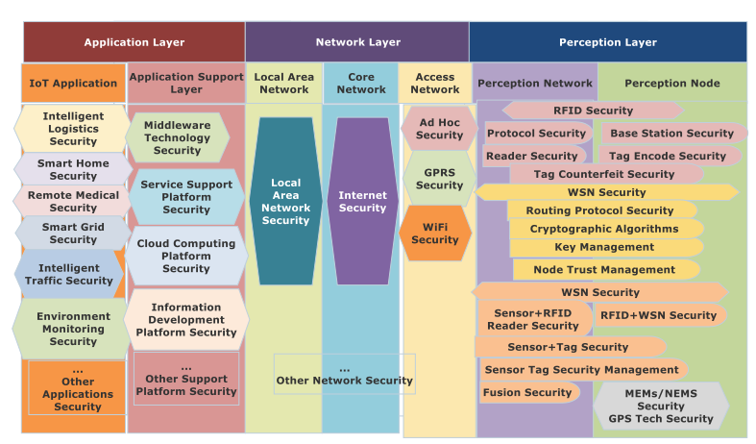
Typical IoT Security Architecture applicable to smart applications

Slide 56
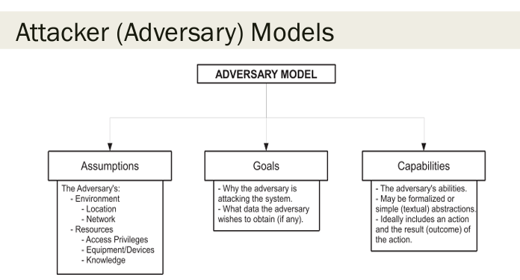

Slide 57
THREAT MODEL
security protocols are the collection of different types of protocols such as ‘‘key management’’, ‘‘user authentication/device authentication’’, ‘‘access control/user access control’’ and ‘‘intrusion detection’’.
In 5G-enabled IoT environment, A widely-accepted model is ‘‘Dolev-Yao (DY) threat model’’.
As per DY Threat model, the guidelines are:
disseminate through a open (insecure) communication
medium.
The terminus nodes functioning as cloud/fog servers, IoT devices are not in general trustworthy.
The existing network adversary has the ability to eavesdrop, delete or update the exchanged messages as the channel is open (insecure).

Slide 58
CK-adversary model
The current de facto standard model for the designing and modeling of an ‘‘authenticated key agreement’’ security mechanism.
a powerful model with capabilities similar to the DY model.
The adversary (A) can handle secret credentials, session states, and session keys in sessions.
‘A’ can also capture smart IoT devices physically and use power analysis attacks to extract stored information, enabling the launch of severe attacks such as identity, password, and session key computation. (attacks include device impersonation, replay, man-in-the-middle, and privileged-insider attacks)

Slide 59
CK-adversary model
A can even create new malicious devices with additional attack functions (wormhole, blackhole) using the extracted information.
These malicious devices are then deployed in the target area. The impact of these attacks results in loss, dropping, delay, or modification of data packets, negatively affecting the performance of communication in a 5G-enabled IoT environment.

Slide 60
CATEGORIES OF SECURITY PROTOCOLS
Security protocols
key management protocols
Authentication/user
authentication protocols
Access control/user access
control protocols
Intrusion detection protocols

Slide 61
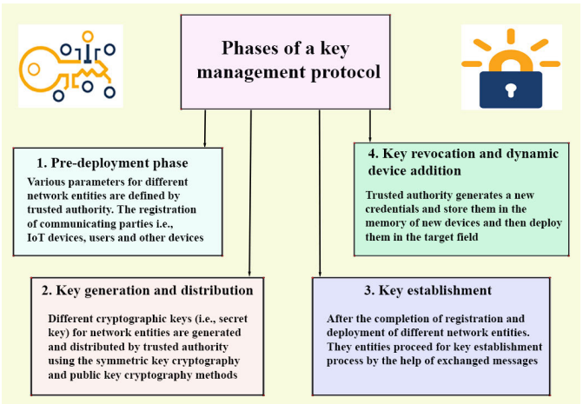

Slide 62
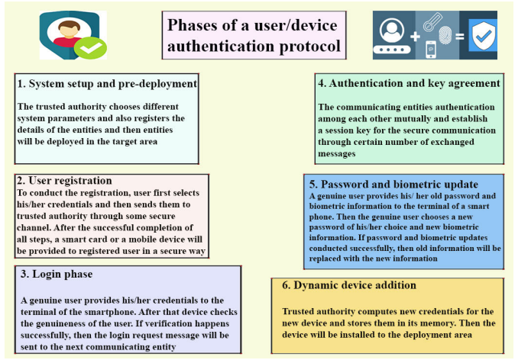

Slide 63
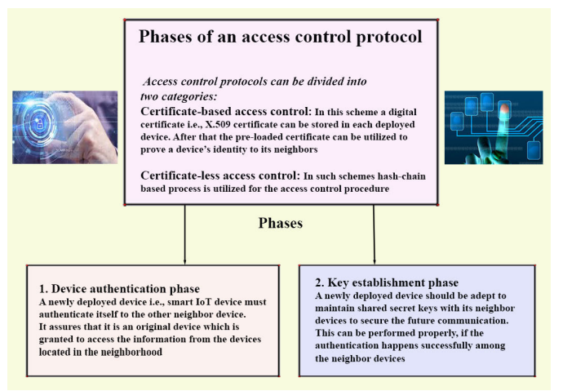

Slide 64
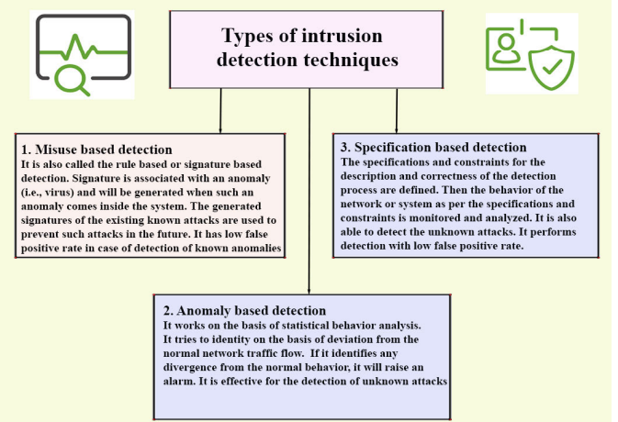

Slide 65
commonly used user authentication protocols
Protocol | Features | Limitations
OAuth 2.0 | - Provides delegated authorization | - Not designed specifically for IoT
OpenID Connect | - Supports identity federation and single sign-on | - Requires additional infrastructure and complexity
Lightweight Authentication Protocol (LwAP) | - Designed for resource-constrained IoT devices | - Limited support for advanced security features
EAP-TLS | - Utilizes TLS for secure authentication and communication | - Requires more computational resources and may be challenging for resource-constrained devices
Kerberos | - Provides mutual authentication and encryption | - Requires a centralized authentication server
Token-based (e.g., JWT) | - Lightweight and scalable approach | - Tokens can be susceptible to token theft or tampering
Certificate-based (e.g., X.509) | - Utilizes digital certificates for authentication | - Certificate management can be complex and resource-intensive
Challenge-Response (e.g., CHAP) | - Offers strong authentication through challenge-response mechanism | - May be vulnerable to replay attacks and requires secure storage of shared secrets

Slide 66
Existing access control protocols in the IoT
Protocol | Features | Limitations
Role-Based Access Control (RBAC) | - Predefined roles with assigned permissions | - Llack flexibility for fine-grained access control
Attribute-Based Access Control (ABAC) | - Access control based on attributes of users, devices, and context | - Requires a robust attribute management infrastructure
Policy-Based Access Control (PBAC) | - Access decisions based on predefined policies | - Policy management complexity may increase with scale
Capability-Based Access Control (CapBAC) | - Decentralized access control through capabilities | - May require additional infrastructure for capability issuance and verification
Attribute-Based Encryption (ABE) | - Data encryption based on attributes, enabling access control | - Computational overhead for encryption and decryption
Identity-Based Encryption (IBE) | - Data encryption based on users' identities | - Potential single point of failure with the identity provider
Lightweight Cryptography-Based Access Control (LWC-AC) | - Specifically designed for resource-constrained IoT devices | - Limited cryptographic strength compared to more traditional access control methods

Slide 67
FUTURE RESEARCH CHALLENGES

Slide 68
Current challenges
Security:
Ensuring secure communication and protecting data from unauthorized access or malicious attacks.
Privacy:
Safeguarding sensitive user information and preventing unauthorized disclosure.
Scalability:
Managing the increasing number of connected devices and data volume efficiently.
Interoperability:
Enabling seamless communication and integration among diverse IoT devices and platforms.
Reliability:
Ensuring consistent and reliable connectivity for critical applications.

Slide 69
Efficient Design of Security Protocols
In the 5G-enabled IoT environment, resource-constrained devices, such as IoT sensors, have limited computation capability, storage size, and battery life.
it is crucial to design security protocols that require low computation power, communication cost, and storage size while maintaining the security of the system.

Slide 70
SCALABILITY OF SECURITY PROTOCOLS
Designing security protocols for heterogenous IoT environments is a complex task due to the varying abilities and concerns of different applications.
Smart healthcare communication environments, for example, involve storing electronic health records on cloud servers for processing and decision-making.
Body area networks (BANs) within this environment consist of different devices generating and transmitting data to the cloud server.

Slide 71
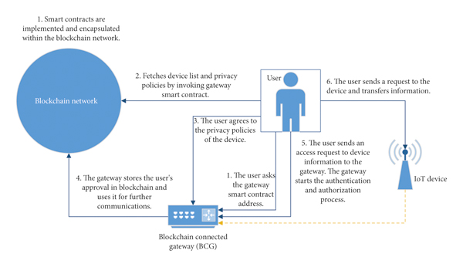
BLOCKCHAIN BASED SECURITY PROTOCOLS DESIGNING
Security protocols can leverage blockchain operations to create blocks containing authentication messages, data messages, or other required functionalities.
The blockchain is shared among legal network entities, enabling access to data stored in the blocks.
Blockchain-based security protocols offer an effective solution for securing the 5G-enabled IoT environment.

Slide 72
Directions for future work
Enhancing security mechanisms:
Developing robust authentication, encryption, and access control protocols to protect IoT devices and data.
Privacy-preserving techniques:
Designing privacy-enhancing solutions that allow data collection while preserving user privacy.
Data analytics and AI:
Exploring advanced analytics and AI algorithms to extract actionable insights from the vast amount of IoT-generated data.
Edge computing:
Utilizing edge computing to perform real-time data processing and reduce latency for time-sensitive applications.

Slide 73






